Slide 1
Cell Division

Slide 2
Two Parts of Cell Division
(1) Mitosis –
(2) Cytokinesis

Slide 3
The Cell Cycle
Cell Cycle – series of events that cells go through as they grow and divide
During the cell cycle, cells:
  Grow
  Prepare for division
  Divide to form two daughter cells

Slide 4
Cell Cycle Cont.
The cell cycle consists of four phases:
  M Phase
  S Phase
  G₁ Phase
  G₂ Phase

Slide 5
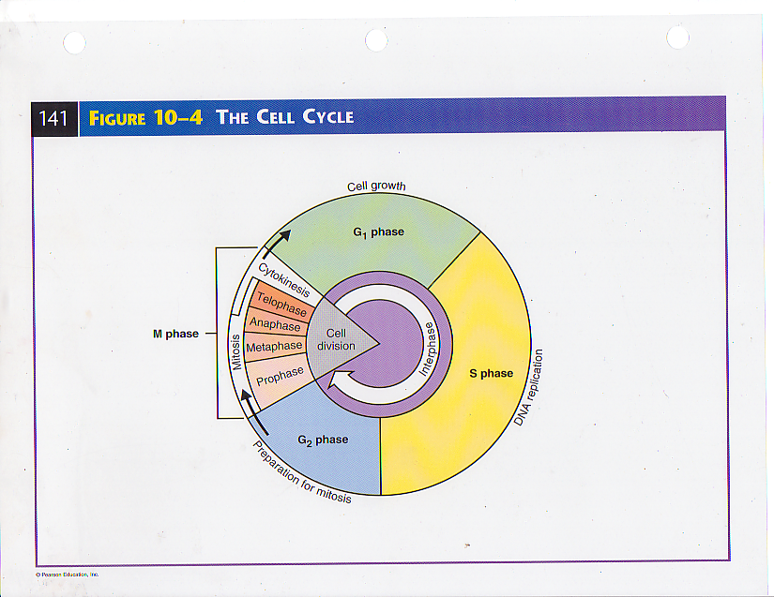

Slide 6
Events of the Cell Cycle
Interphase – period of the cell cycle between cell divisions – preparation for Mitosis
Not considered mitosis!!
    Includes G₁, S, and G₂ phases
G₁ Phase –
S –
G₂ –

Slide 7
Mitosis (4 Phases)
Prophase
  Longest phase of mitosis
  Chromosomes become visible and coil tightly
  Spindle fibers form
  Nuclear envelope breaks down
  Nucleolus disappears
  Centrioles migrate to opposite sides of nucleus

Slide 8
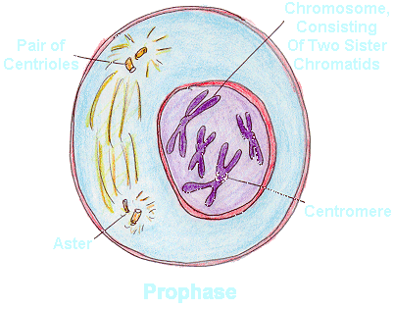

Slide 9
Metaphase
2nd Phase of mitosis
Lasts only a few minutes
Chromosomes line up in the middle of the cell
Microtubules (spindle fibers) connect centromere of each chromosome to spindle

Slide 10
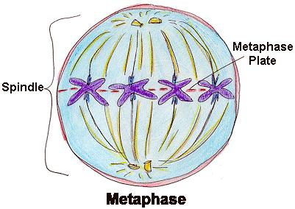

Slide 11
Anaphase
3rd phase of mitosis
Centromeres split – allowing sister chromatids to separate and become individual chromosomes
Chromosomes separate and approach the poles of the spindle (opposite ends of the cell)

Slide 12
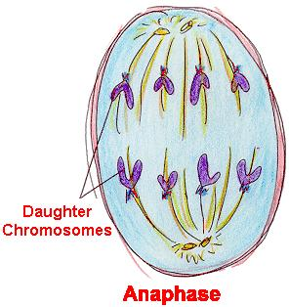

Slide 13
Telophase
Final stage of mitosis
Chromosomes disperse into a tangle of dense material
Nuclear envelope reforms around chromosomes
Spindle fibers break apart and nucleolus becomes visible

Slide 14
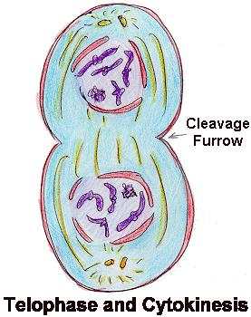

Slide 15
Cytokinesis
Cytokinesis – division of the cytoplasm
  Completes M phase
  The cytoplasm is pinched into equal parts
  Each new part contains its own nucleus and organelles

Slide 16
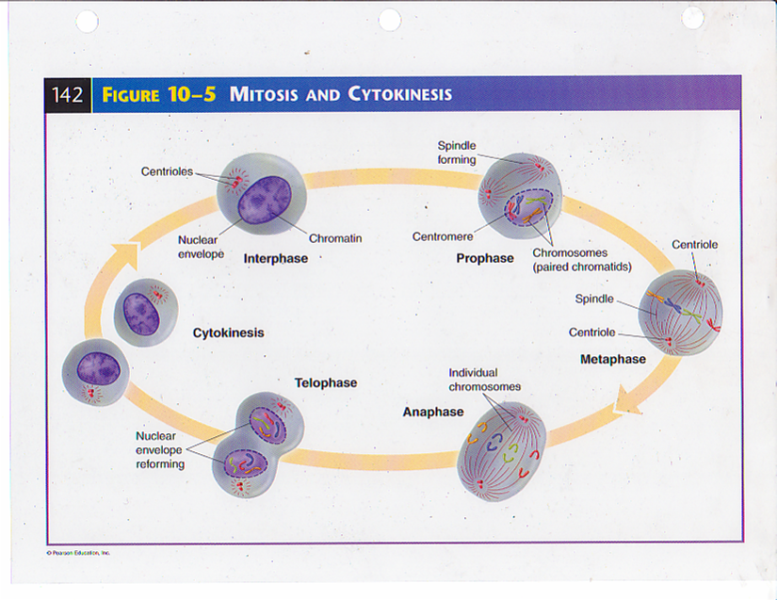

Slide 17
